Slide 1
Routing Security
16-17 November 2021
Central Asia Peering Forum
MANRS for the Internet
  Kevin Meynell
  Senior Manager, Technical & Operational Engagement
    meynell@isoc.org

Slide 2
What is Routing and why is it needed?
    The Internet is actually a global system of interconnected computer networks using the TCP/IP protocols
    Routing is needed to get packets from one destination to another (unless on the same subnet)
    Routers (aka gateways) are specialised computing devices that discover other connected networks and forward packets to them
    Each network is connected to the rest of Internet with a router
    Packets are forwarded by routers to other routers or final destination, based on IP addresses (usually blocks of IP addresses known as prefixes)
    Routers use Border Gateway Protocol (BGP) to exchange “reachability information” - networks they know how to reach
    Routers build a routing table (i.e. “road map”) to pick the best route when sending a packet

Slide 3
Global Routing System Overview
(as of 13 November 2022)
73,995 networks known as Autonomous Systems connected to Internet, each using a unique Autonomous System Number (ASN) for identification
937,244 advertised IP prefixes (routes)
https://www.caida.org/

Slide 4

The Routing Problem
Caption 10/12pt
  Caption body copy
The Border Gateway Protocol (BGP) used by the Internet routing system is based entirely on unverified trust between networks
  No built-in validation that updates are legitimate
  Any network can announce any ASN or IP prefix
  Any network can claim to be another network

Slide 5
Routing Incidents Cause Real World Problems
Event | Explanation | Repercussions | Example
Route Leak | A network operator with multiple upstream providers (often due to accidental misconfiguration) announces to one upstream provider that is has a route to a destination through the other upstream provider. | Can be used for a MITM, including traffic inspection, modification and reconnaissance. | June 2019. Verizon accepted incorrect routes from DQE Communications that diverted traffic destined for Cloudflare, Facebook & Amazon.
Prefix/Route Hijacking | A network operator or attacker impersonates another network operator, pretending that a server or network is their client. | Packets are forwarded to the wrong place and can cause Denial of Service (DoS) attacks or traffic interception. | The 2008 YouTube hijack April 2018 Amazon Route 53 hijack
IP Address Spoofing | Someone creates IP packets with a false source IP address to hide the identity of the sender or to impersonate another computing system. | The root cause of reflection DDoS attacks | March 1, 2018. Memcached 1.3Tb/s reflection-amplification attack reported by Akamai

Slide 6
The routing system is constantly under attack – incidents every day
http://bgpstream.com/

Slide 7
What can be done to fix routing problems?

Slide 8
Why is routing security so hard?
Each operator needs to contribute to routing security
Little incentive – implementing routing security measures doesn’t bring immediate benefits for an operator
Routing incidents can be hard to identify, debug and fix
This is a typical collective action problem!

Slide 9
Introduction to MANRS
Provides well-defined actions to eliminate the most common threats in the global routing system
Brings together established industry best practices
Based on collaboration among participants and shared responsibility for the Internet infrastructure
4 programmes for Network Operators, IXPs, CDN/Cloud Providers & Vendors (no fees)

Slide 10
What are we looking to achieve?
Everyone benefits from improved Routing Security
Encourage networks to implement routing security best practices + raise customer awareness so they demand this
Help networks to easily identify and address problems with customers or peers
The more operators that apply MANRS actions, the fewer incidents there will be, and the less damage they can do
Develop a database of routing incidents to demonstrate where problems exist + whether things improve over time in response to better routing security measures.
Build a self-regulating community of security-minded network operators committed to making the global routing infrastructure more robust and secure

Slide 11
MANRS Actions – Network Operators Programme
Launched November 2014. Actions 1, 3 and 4 are mandatory. Action 2 is optional.
Filtering
Prevent propagation of incorrect routing information
  Ensure the correctness of your own announcements and announcements from your customers to adjacent networks with prefix and AS-path granularity
Anti-spoofing
Prevent traffic with spoofed source IP addresses
  Enable source address validation for at least single-homed stub customer networks, their own end-users, and infrastructure
Coordination
Facilitate global operational communication and coordination between network operators
  Maintain globally accessible up-to-date contact information in relevant RIR database and/or PeeringDB
Global Validation
Facilitate validation of routing information on a global scale
  Publish your routing data, so others can validate
  Registering number resources in an IRR and/or
  creating ROAs for them

Slide 12
MANRS Actions – IXP Programme
Launched April 2018. Actions 1 and 2 are mandatory, plus at least one additional action is required.
Action 1
Prevent propagation of incorrect routing information
  This mandatory action requires IXPs to implement filtering of route announcements at the Route Server based on routing information data (IRR and/or RPKI).
Action 2
Promote MANRS to the IXP membership
  IXPs joining MANRS are expected to provide encouragement or assistance for their members to implement MANRS actions.
Action 3
Protect the peering platform
  This action requires that the IXP has a published policy of traffic not allowed on the peering fabric and performs filtering of such traffic.
Action 4
Facilitate global operational communication and coordination
  The IXP facilitates communication among members by providing necessary mailing lists and member directories.
Action 5
Provide monitoring and debugging tools to the members.
  The IXP provides a looking glass for its members.

Slide 13
MANRS Actions - CDN & Cloud Programme
Was launched on 1 April 2020 to complement existing Network Operators and IXP programme.
Principles developed by large industry players including Akamai, Azion, Cloudflare, Comcast, Facebook, Google, Microsoft, Nexica Oracle, Redder, Telefonica, TORIX, Verisign.
Conformance with Actions 1-5 is mandatory. Action 6 is optional.
Action 1
Prevent propagation of incorrect routing information
Egress filtering
Ingress filtering – non-transit peers, explicit whitelists
Action 2
Prevent traffic with illegitimate source IP addresses
  Anti-spoofing controls to prevent packets with illegitimate source IP address
Action 3
Facilitate global operational communication and coordination
  Contact information in relevant RIR database and/or PeeringDB
Action 4
Facilitate validation of routing information on a global scale
  Publicly document ASNs and prefixes that are intended to be advertised to external parties
Action 5
Encourage MANRS adoption
  Actively encourage MANRS adoption among the peers
Action 6
Provide monitoring and debugging tools to peering partners
  Provide monitoring tools to indicate incorrect announcements from peers filtered by CDN & Cloud

Slide 14
MANRS Actions for Vendors
Action 1
Provide Solutions
Filtering
Anti-Spoofing
Filtering (IXP)
Protect L2 (IXP)
Action 2
Promote
2-1 Training
2-2 Lab
2-3 Technical Resources
2-4 Hands-on
Ongoing Activities
Advisory
Development
Contribution
Promotion

Slide 15
The MANRS Observatory
Checking Conformance
Notes:
https://www.manrs.org/wp-content/uploads/sites/14/2017/10/MANRS-451-Study-Report.pdf

Slide 16

MANRS Observatory https://observatory.manrs.org/
Provides a factual state of MANRS readiness over time
Measurements are:
Transparent – using publicly accessible data
    BGPStream / GRIP
    CIDR Report
    CAIDA Spoofer Database
    RIPE Database / RIPE Stat
    PeeringDB
    IRRs
Passive – no cooperation from networks required
Evolving – MANRS community decide what gets measured and how

Slide 17
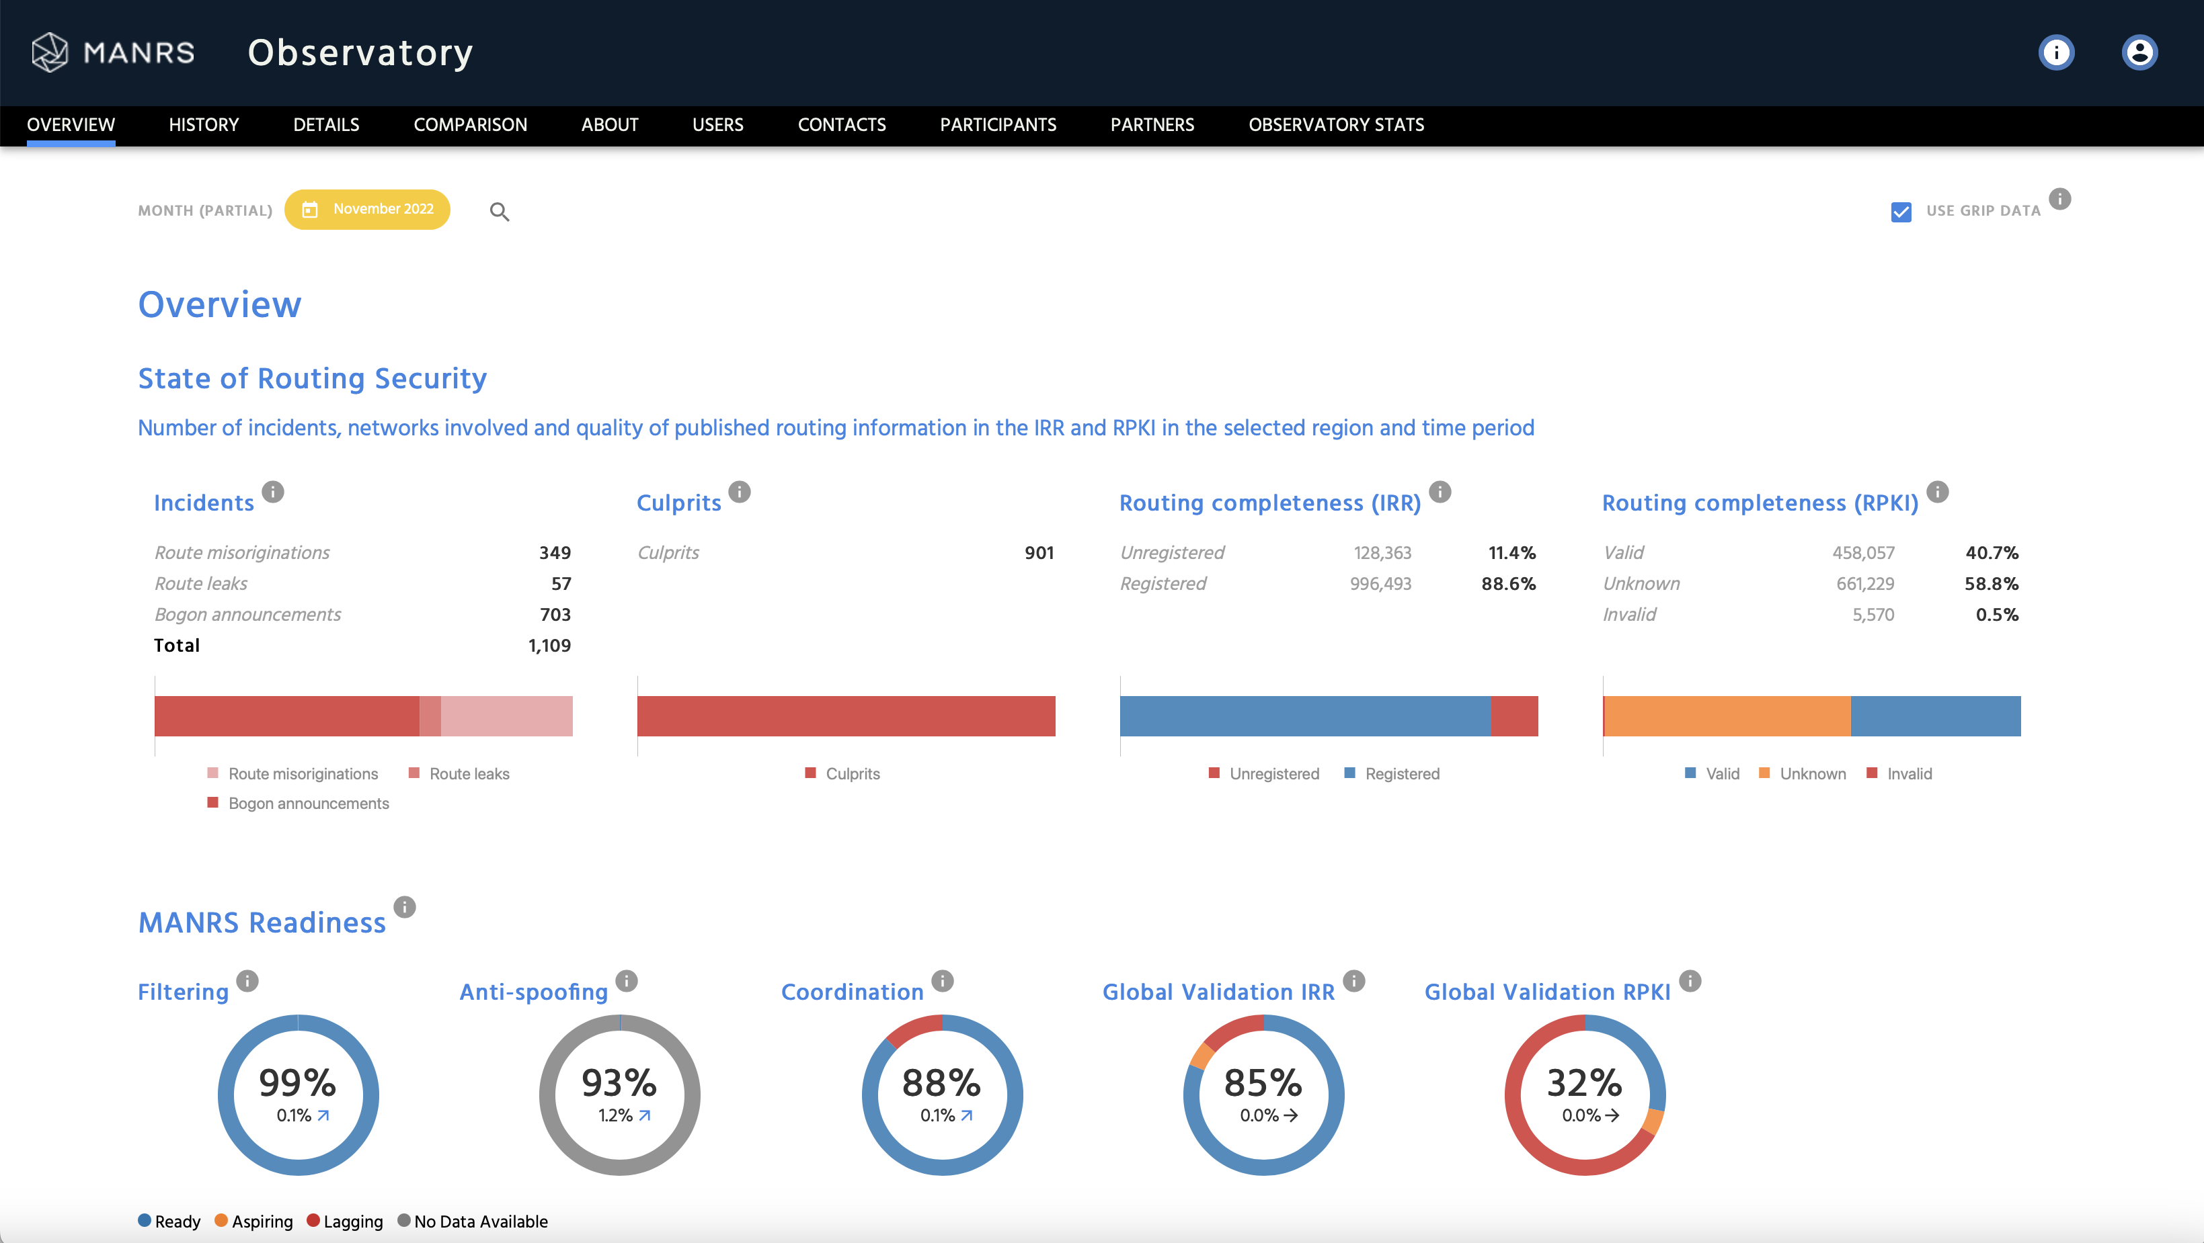
MANRS Observatory

Slide 18
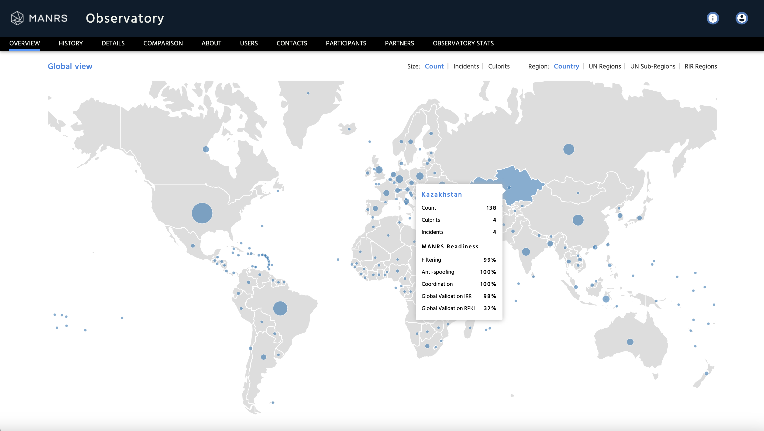
MANRS Observatory

Slide 19
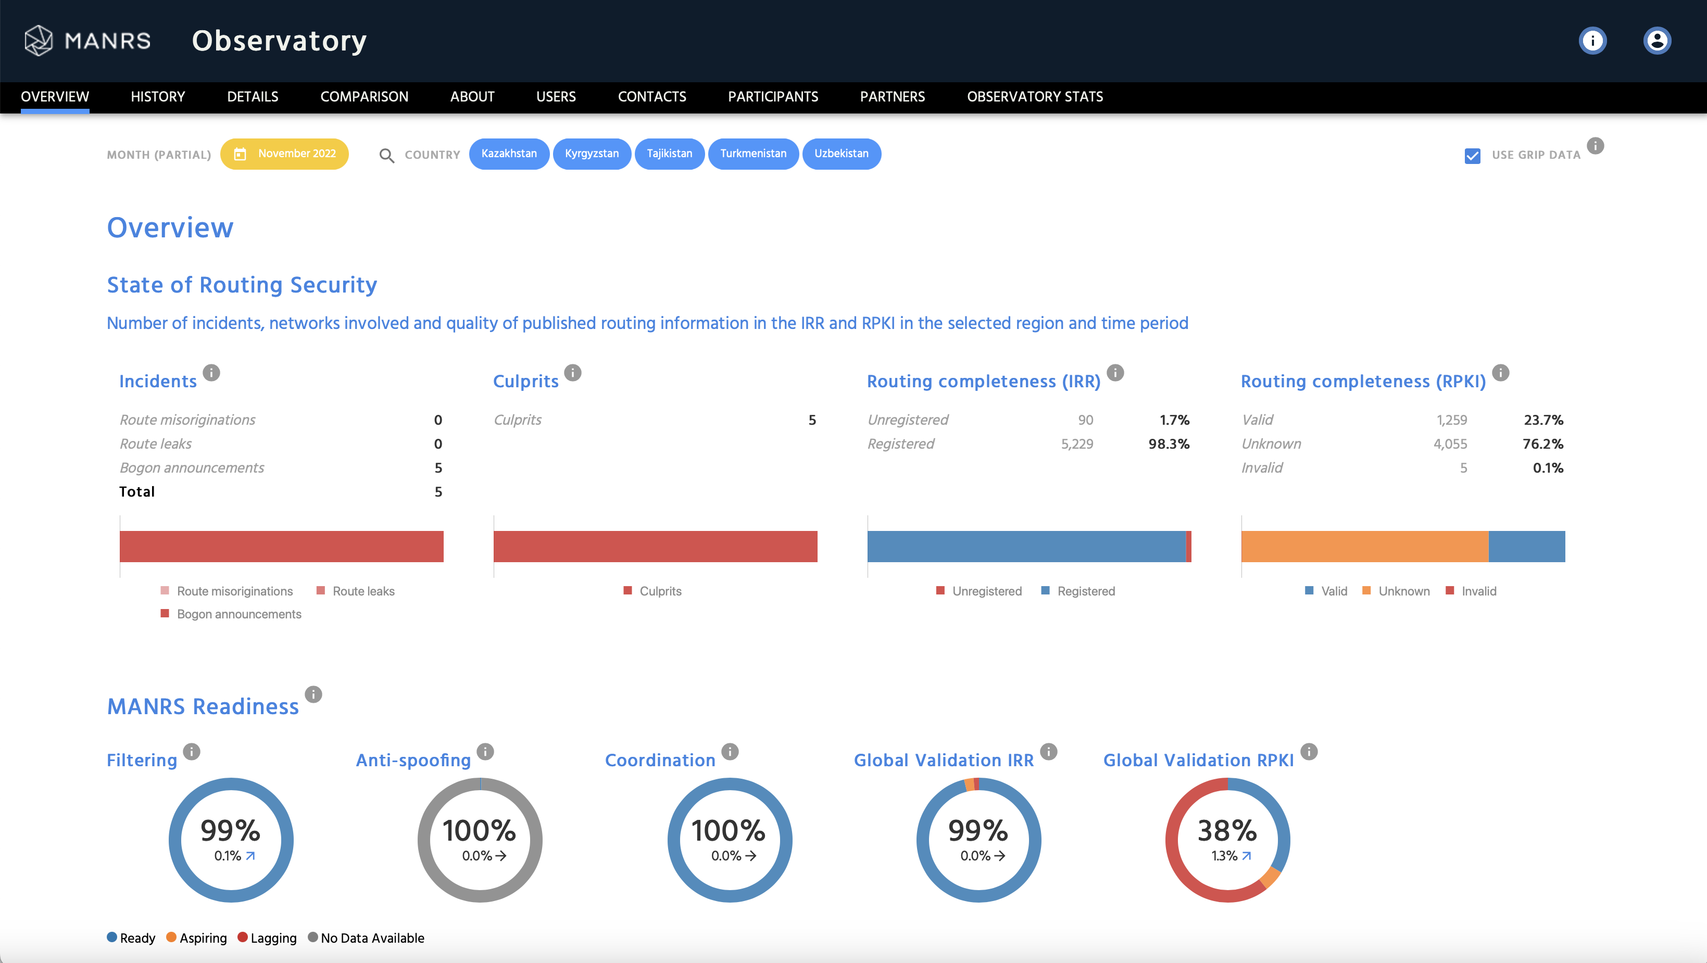
MANRS Observatory

Slide 20
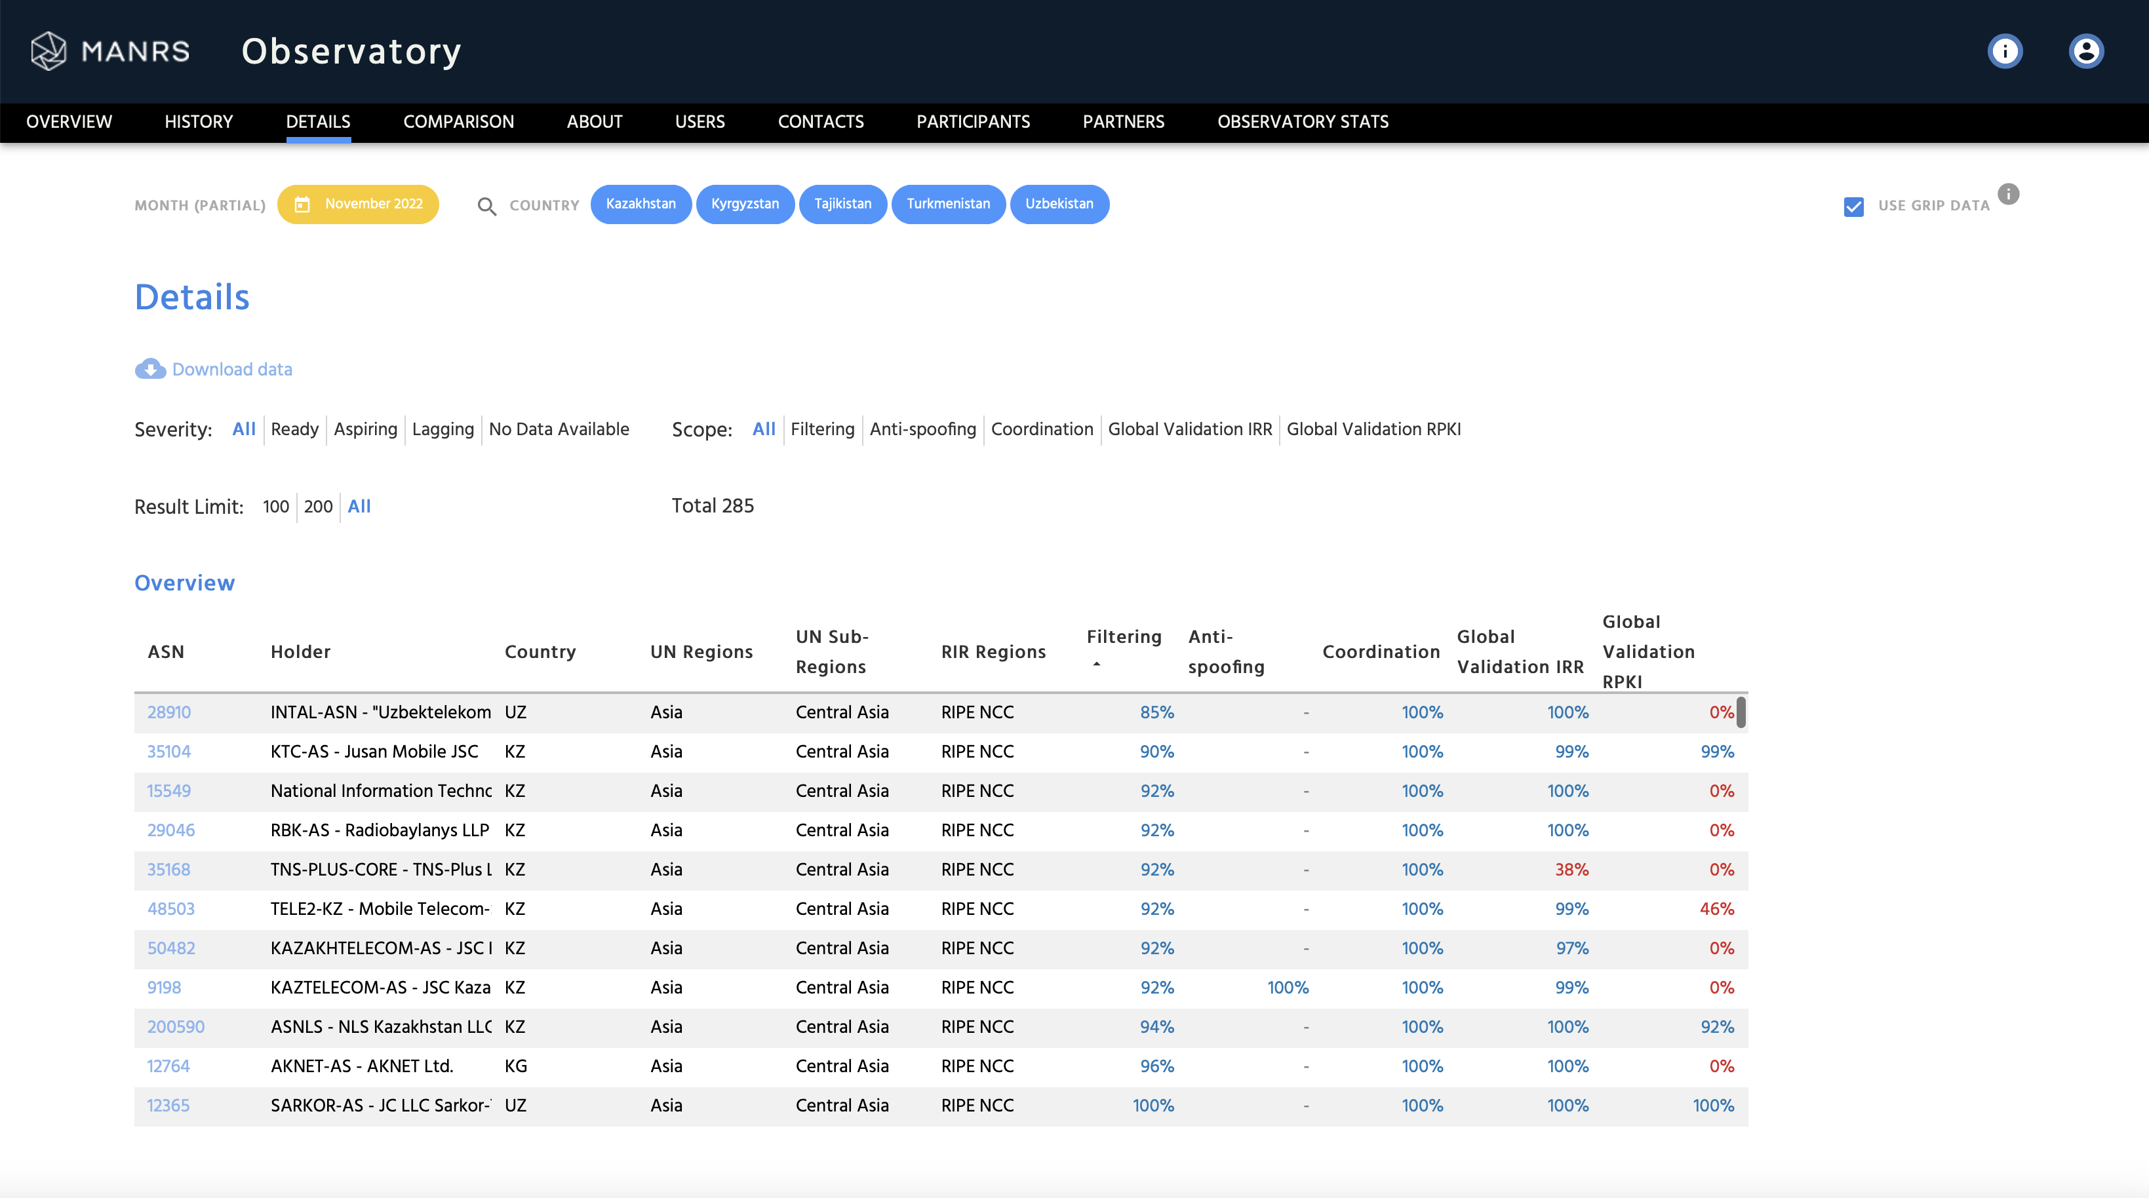
MANRS Observatory

Slide 21
MANRS Implementation Guide for Network Operators
If you’re not ready to join yet, implementation guidance is available to help you.
Based on Best Current Operational Practices deployed by network operators around the world
Recognition from the RIPE community by being published as RIPE-706
  https://www.manrs.org/bcop/

Slide 22
MANRS Participation
Notes:
https://www.manrs.org/wp-content/uploads/sites/14/2017/10/MANRS-451-Study-Report.pdf

Slide 23
300
742 ISPs (929 ASNs)
106 IXPs
22 CDN & Clouds
6 Equipment Vendors
9
9

Slide 24
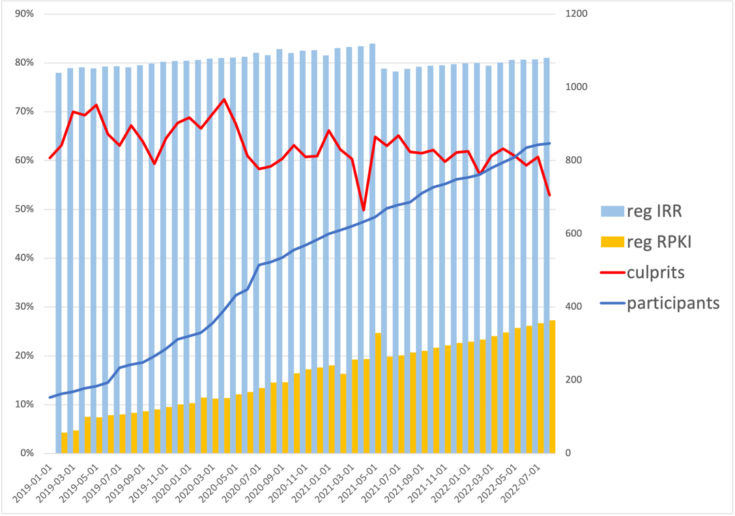
Progress in routing security
81% of all ASNs have routes registered in IRRs and 27% in RPKI, and these numbers steadily grow.
Number of “culprits” – ASNs implicated in one or more suspicious routing events – declines
Data sources: MANRS Observatory, BGPStream, GRIP.

Slide 25



LEARN MORE:
https://www.manrs.org
Follow us:
/RoutingMANRS

